Slide 1

Engineering Science Thesis
Sleep staging AI model design and ASIC implementation
Tristan Robitaille (EngSci 2T3 + PEY) Supervisor: Prof. Xilin Liu (X-Lab)
Fall 2023 – Winter 2024

Slide 2
Outline
Background
Literature Review
Model Description
Accelerator Design
Results
Analysis & Future Work
Conclusion
Fall 2023 – Winter 2024

Slide 3
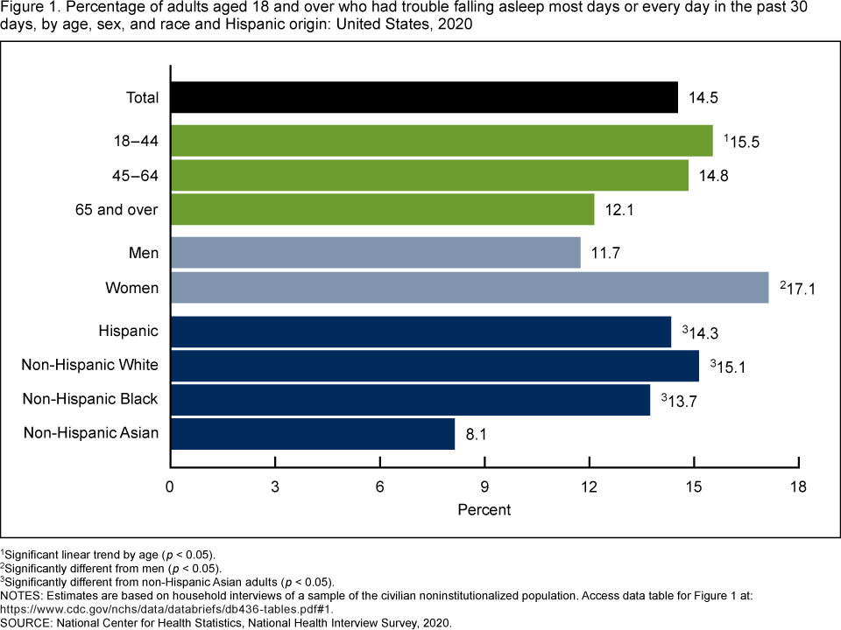
1
Background
Insomnia is prevalent: ~15% of Americans have troubling falling asleep most nights¹!
Neuromodulation can help
Fall 2023 – Winter 2024
Notes:
Insomnia is a large problem!
Neuromodulation can help!
Graph source: https://www.ncbi.nlm.nih.gov/pmc/articles/PMC5353813/

Slide 4
2
What is Neuromodulation?
Alteration of nervous signals through application of a stimulus
Acoustic
Magnetic
Transcranial AC, DC
Goal: Induce correct sleep stage for patient
Relatively recent, active field of research
Fall 2023 – Winter 2024

Slide 5
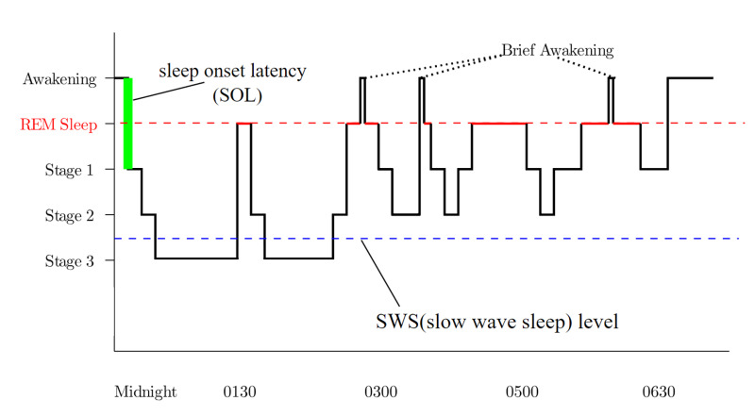
3
What is Sleep Staging?
Inferring sleep stage automatically
Wake
N1
N2
N3
REM
Progressively deeper
Fall 2023 – Winter 2024
Notes:
Hypnogram: https://www.ncbi.nlm.nih.gov/books/NBK560713/figure/article-28328.image.f1/

Slide 6
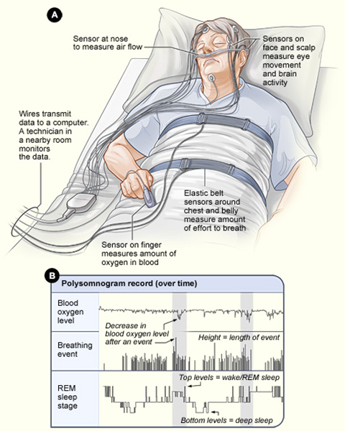
4
What is Polysomnography (PSG)?
EEG, EOG, EMG, ECG
Heart rate
Airflow
Temperature
Oxygen level
Fall 2023 – Winter 2024
Notes:
Polysomnography patient drawing: https://www.psychdb.com/neurology/polysomnography
2:00 min

Slide 7
4
What is Polysomnography (PSG)?
}
EEG, EOG, EMG, ECG
Heart rate
Airflow
Temperature
Oxygen level
10’s of wires
Cumbersome
Time-consuming
Fall 2023 – Winter 2024
Notes:
Polysomnography patient drawing: https://www.psychdb.com/neurology/polysomnography

Slide 8
5
Summary of Motivation
Insomnia
Fall 2023 – Winter 2024

Slide 9
5
Summary of Motivation
Insomnia
↓
Neuromodulation
Fall 2023 – Winter 2024

Slide 10
5
Summary of Motivation
Insomnia
↓
Neuromodulation
↓
Sleep staging
Fall 2023 – Winter 2024

Slide 11
5
Summary of Motivation
Insomnia
↓
Neuromodulation
↓
Sleep staging
↓
Impractical PSG → Need novel wearable
Fall 2023 – Winter 2024

Slide 12
5
Summary of Motivation
Insomnia
↓
Neuromodulation
↓
Sleep staging
↓
Impractical PSG → Need novel wearable
Fall 2023 – Winter 2024

Slide 13
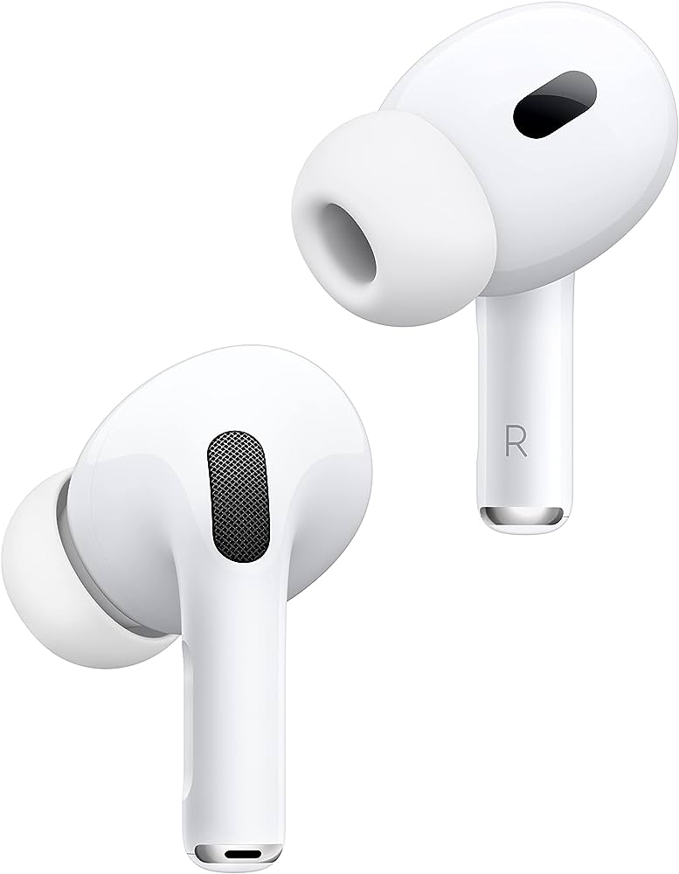
6
Proposal / Research Question
In-ear device performing:
EEG sampling
Automatic sleep staging
Acoustic neuromodulation
Fall 2023 – Winter 2024
Notes:
3:15

Slide 14
6
Proposal / Research Question
In-ear device performing:
EEG sampling
Automatic sleep staging
Acoustic neuromodulation
Is it feasible?
Fall 2023 – Winter 2024

Slide 15
6
Proposal / Research Question
In-ear device performing:
EEG sampling
Automatic sleep staging
Acoustic neuromodulation
Develop model + accelerator
Fall 2023 – Winter 2024

Slide 16
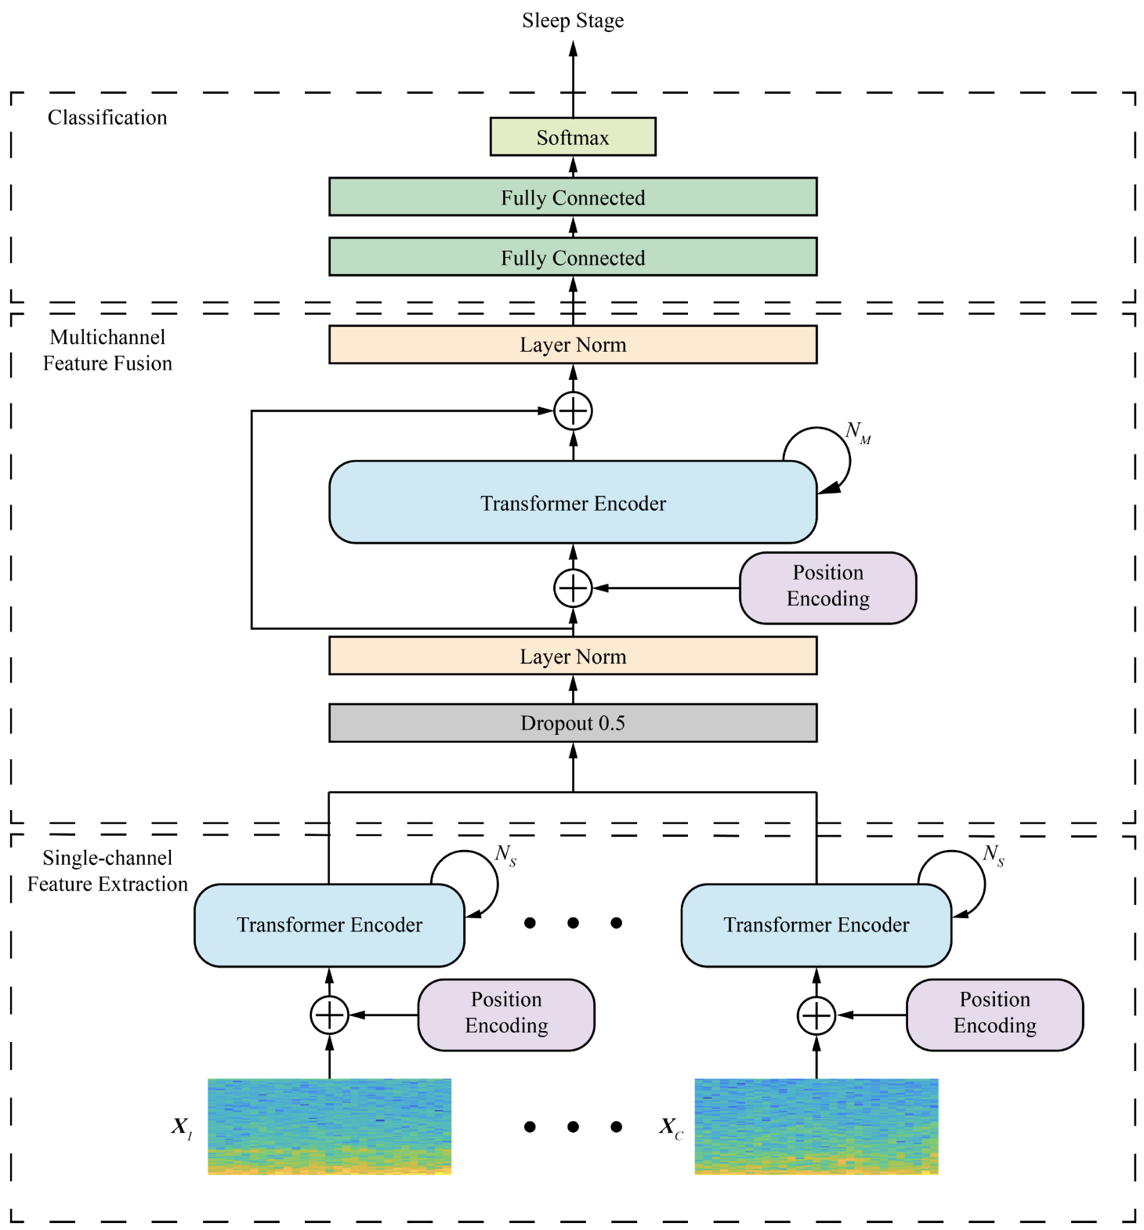
7
Literature review – Sleep Staging AI
Sleep staging using ML since 2017
CNN, RNN, Transformers
Most published accuracy > 85%
Some authors claim problem is “solved”
Most models have > 1M weights
MultiChannelSleepNet
Fall 2023 – Winter 2024
Notes:
MultiChannelSleepNet: https://ieeexplore.ieee.org/stamp/stamp.jsp?tp=&arnumber=10146380
Merges encoder output of multiple EEG channels for higher accuracy
Managed one of the highest accuracy at 87.2%

Slide 17
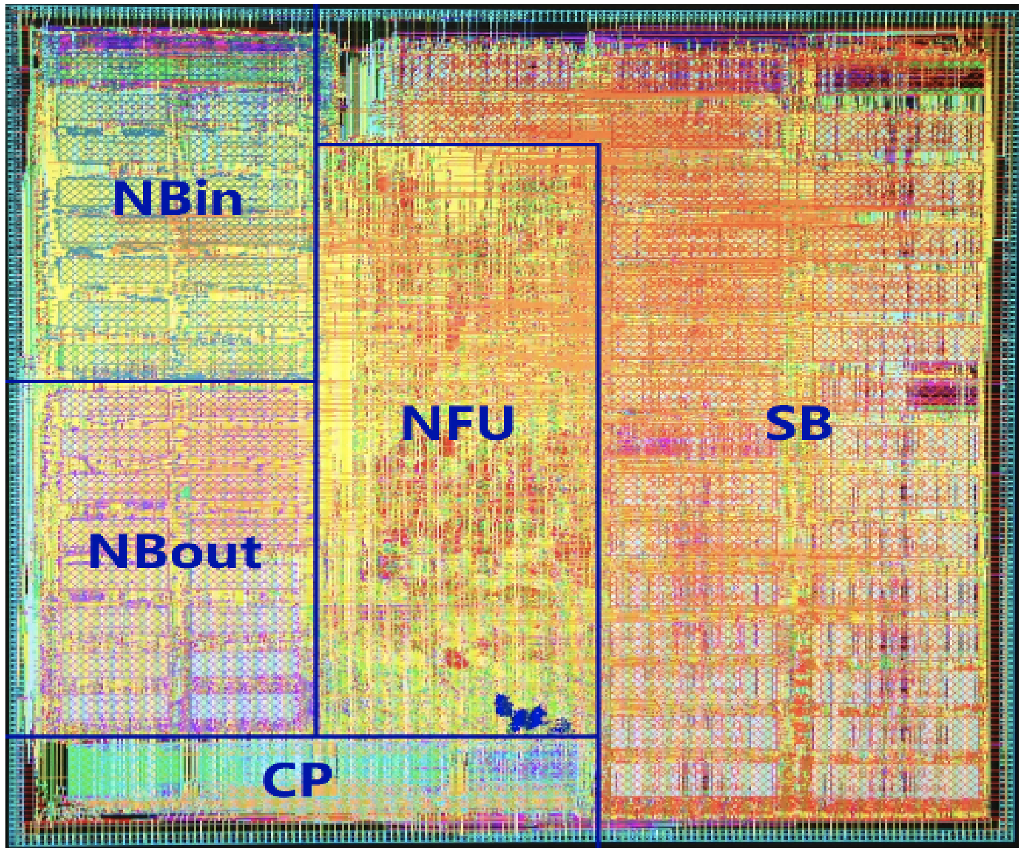
8
Literature review – ASIC Accelerator
CPUs: Significant overhead
GPUs: Expensive + power hungry
FPGA: Expensive
ASIC: Most efficient, but inflexible
First accelerator: DianNao @ 452Gop/s (fixed-point)
DianNao 65nm die
Fall 2023 – Winter 2024
Notes:
DianNao: https://users.cs.duke.edu/~lkw34/papers/diannao-asplos2014.pdf

Slide 18
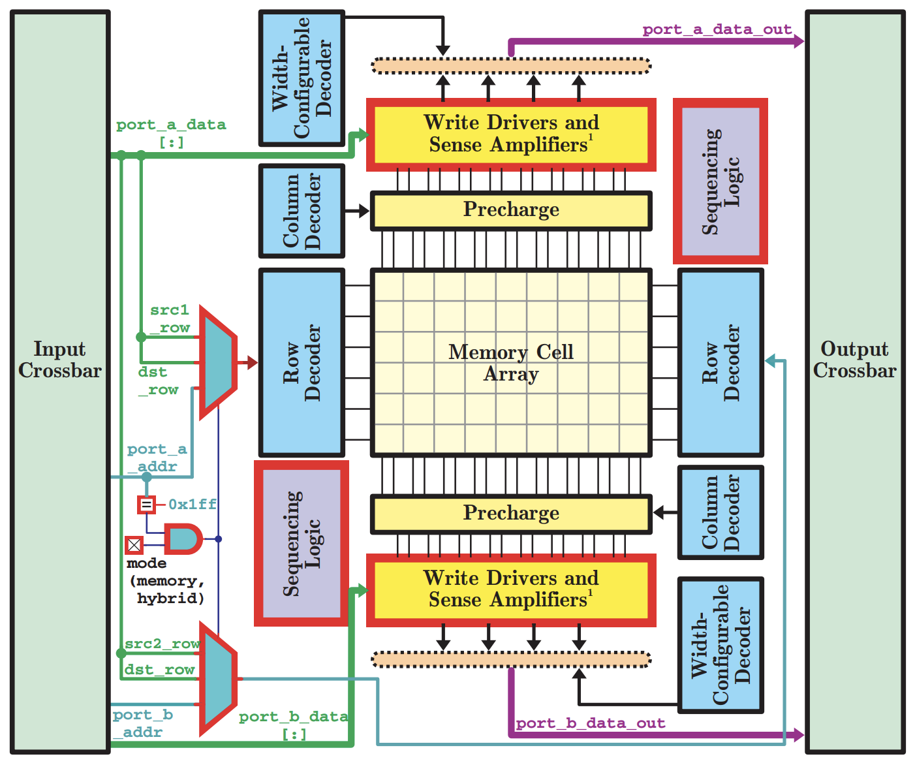
9
Literature review – ASIC Accelerator
Recent trend: Compute-in-Memory
Data movement is expensive…
…put compute near memory!
CoMeFa: BRAM CiM for 55% reduction in power
Dataflow: Non-von-Neumann architecture → No trad. instructions
CoMeFa
Fall 2023 – Winter 2024
Notes:
CoMeFa: https://arxiv.org/pdf/2203.12521.pdf

Slide 19
10
Requirements
Model
ASIC
Accuracy: ≥ 80%
Competitive with PSG
Size: < 125kB
Fit in ASIC
Area: < 2mm²
Fit in-ear
Effective power: < 5mW
All-night battery life
Inference latency : < 3s
Limit phase offset
Fall 2023 – Winter 2024
Notes:
CoMeFa: https://arxiv.org/pdf/2203.12521.pdf

Slide 20
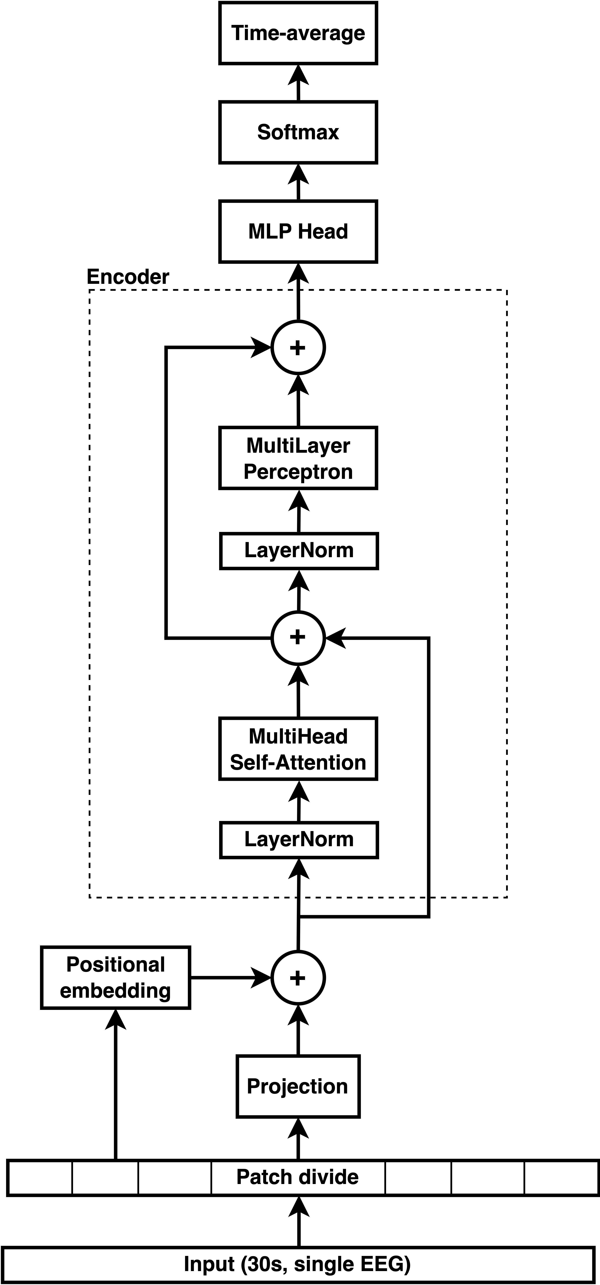
11
Vision Transformer Model
Sequence-to-one
Single encoder
Sleep epoch split in patches
Attention: 8 heads QKV
Window average of 3 softmax
Fall 2023 – Winter 2024

Slide 21
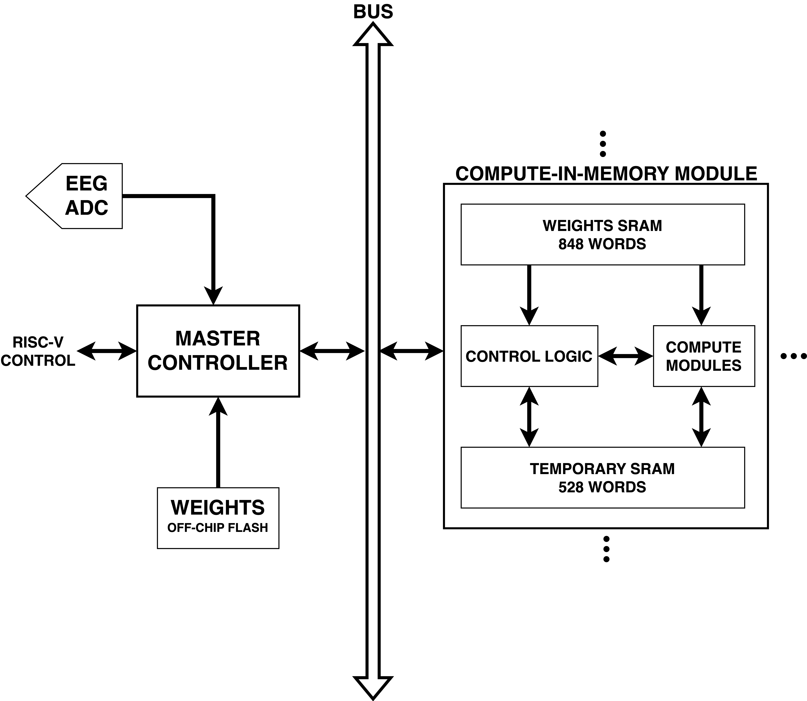
12
Accelerator Design
Master + 64 CiM architecture
Master
High-level inference steps
Interface w/ ADC, mem., RISC-V
Bidirectional bus
Dense and transpose broadcasts
Fall 2023 – Winter 2024

Slide 22
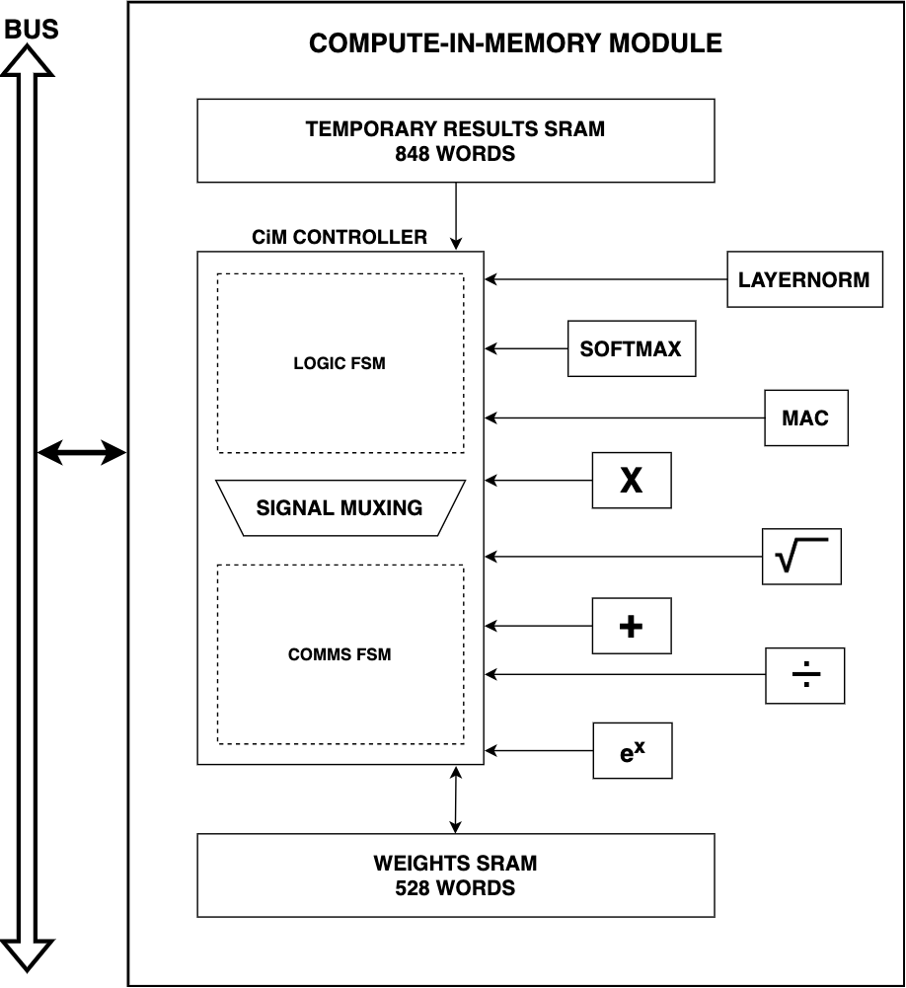
13
Accelerator Design
CiM have hardcoded compute
“Composite” modules share basics
SRAM:
848 words of intermediate results
528 words for weights
Fall 2023 – Winter 2024

Slide 23
14
Results
Model
ASIC
Accuracy: 82.9% (N1/2 merged) ✔
Size: 31589 words ✔
Area: 3.86mm² ✘
Effective power: 3.05mW ✔
Latency: 6.87ms ✔
f_{max}: 758MHz
Fall 2023 – Winter 2024

Slide 24
14
Results
Model
ASIC
Accuracy: 82.9% (N1/2 merged) ✔
Size: 31589 words ✔
Area: 3.86mm² ✘
Effective power: 3.05mW ✔
Latency: 6.87ms ✔
f_{max}: 758MHz
ASIC is too large!...
Fall 2023 – Winter 2024

Slide 25
15
Analysis and Future Work
…but there’s a plan
Fall 2023 – Winter 2024

Slide 26
15
Analysis and Future Work
Model
Train on STAGES
Additional channels
𝛾 and β elimination
…but there’s a plan
Fall 2023 – Winter 2024

Slide 27
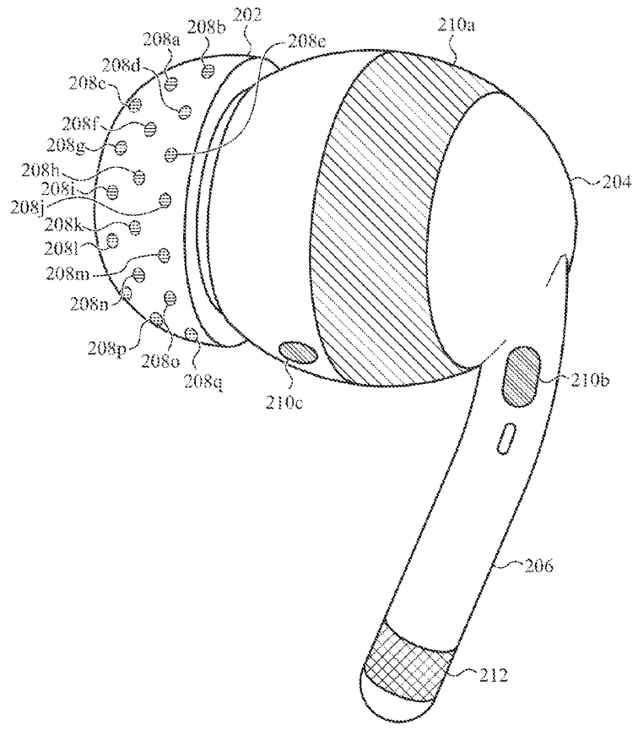
15
Analysis and Future Work
Galvanic Skin Response
EEG, EMG, EOG, ECG
Blood Volume Pulse
Fall 2023 – Winter 2024
Notes:
Patent: https://patentimages.storage.googleapis.com/e2/4d/92/a20ceacf02d9db/US20230225659A1.pdf

Slide 28
15
Analysis and Future Work
Model
ASIC
Train on STAGES
𝛾 and β elimination
Additional channels
Centralized memory
Centralized compute
Bus elimination
More aggressive power gating
Optimize Q format
…but there’s a plan
Fall 2023 – Winter 2024

Slide 29
15
Analysis and Future Work
Leakage reduction: - 39.55mW
Area reduction: - 2.11mm²
Latency increase: + 0.305s
Fall 2023 – Winter 2024

Slide 30
15
Analysis and Future Work
}
Leakage reduction: - 39.55mW
Area reduction: - 2.11mm²
Latency increase: + 0.305s
All requirements met!
Fall 2023 – Winter 2024

Slide 31
16
Conclusion
Addressing insomnia needs neuromodulation, which needs sleep staging
There is a path towards effective and practical in-ear sleep staging
Results are encouraging…maybe an ASIC isn’t needed
RISC-V vector extension
RISC-V + CGRA
Fall 2023 – Winter 2024

Slide 32
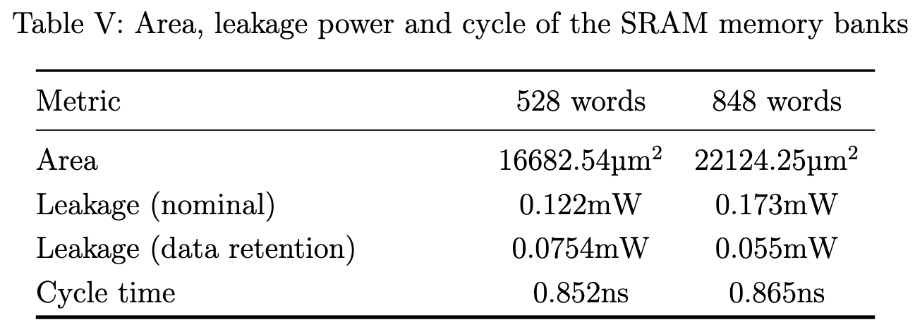
16
Appendix – Full results
Memory results
Fall 2023 – Winter 2024

Slide 33
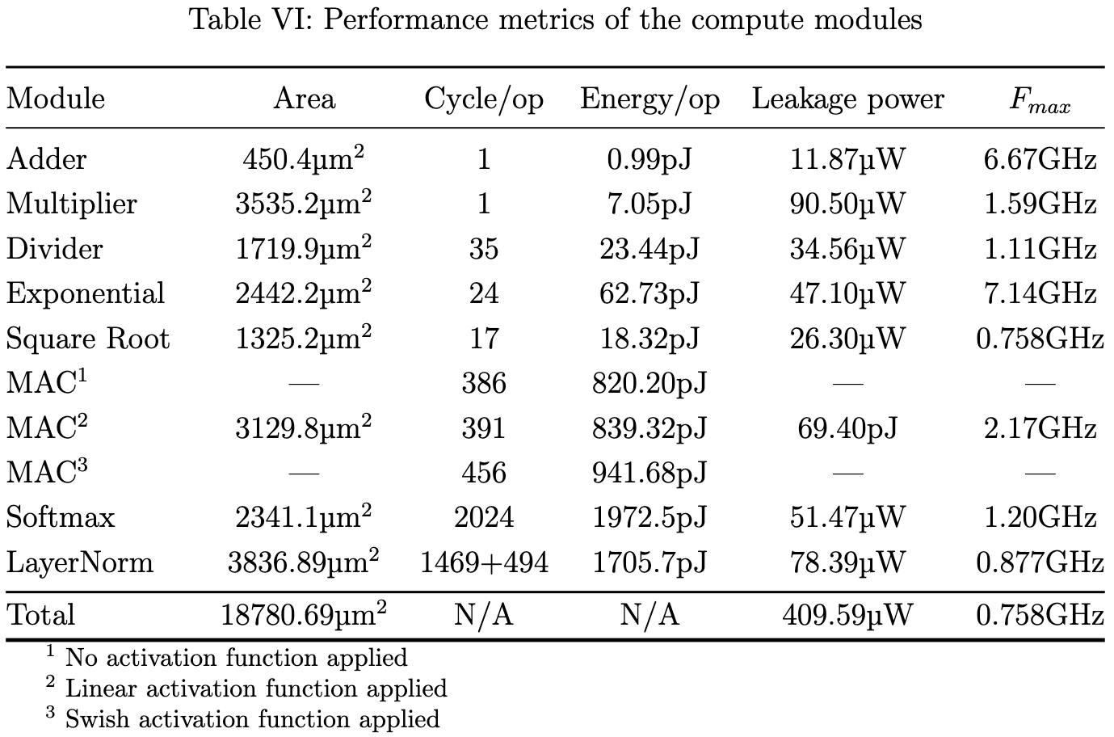
16
Appendix – Full results
Compute modules results
Fall 2023 – Winter 2024

Slide 34
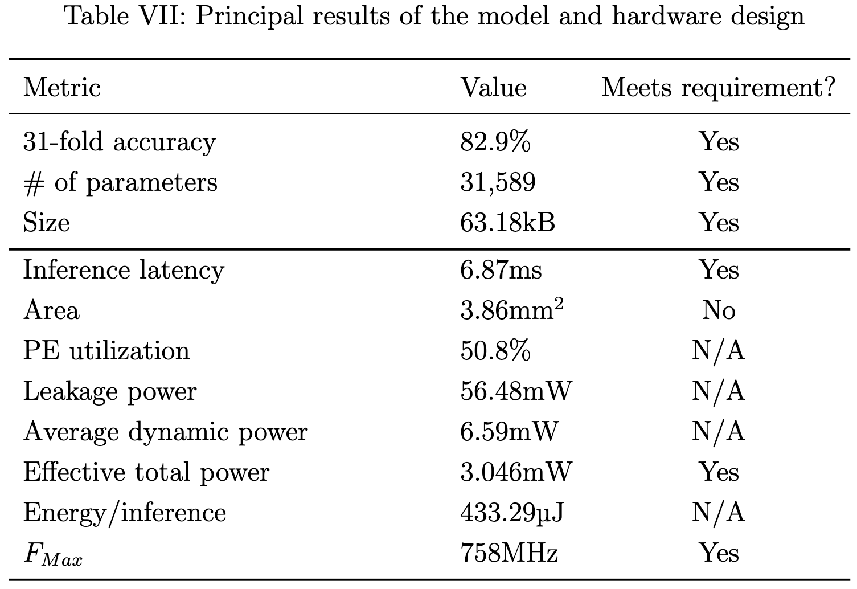
16
Appendix – Full results
System-level results
Fall 2023 – Winter 2024

Slide 35
15
Appendix - Acknowledgments
Professor Xilin Liu
My father: Claude Robitaille
Computer architecture professors: Mark Jeffrey, Andreas Moshovos, Jason Anderson, Natalie Enright-Jerger and David Halupka
Compute Canada team
Professors Lisa Romkey and Alan Chong for ESC499 organization
Family and friends
Fall 2023 – Winter 2024

